Slide 1

OPTION API

Slide 2
What is Option API?
Options API is an old way to structure a Vue.JS application. We use Options API in a Vue application to write and define different components. Due to some limitations in this API, Composition API was introduced in Vue 3.

Slide 3

Option State
data
watch
props
emits
computed
methods

Slide 4
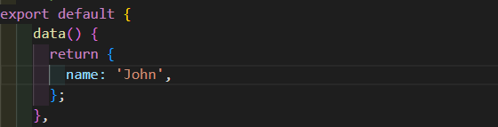
Option State
data
Type
Details
The function is expected to return a plain JavaScript object, which will be made reactive by Vue. After the instance is created, the reactive data object can be accessed as this.name.

Slide 5
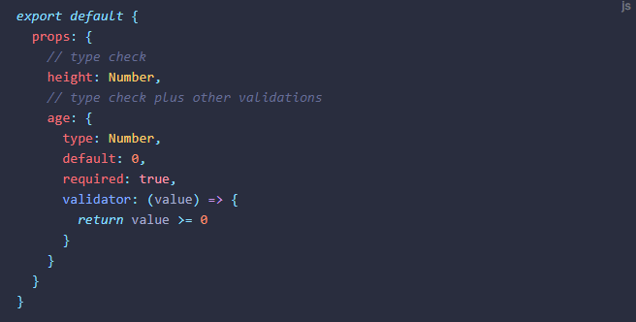
Option State
props
Type
Details
Component props can be declared in two forms:
Simple form using an array of strings
Full form using an object where each property key is the name of the prop, and the value is the prop's type (a constructor function) or advanced options.

Slide 6

Option State
computed
Type
Details
The option accepts an object where the key is the name of the computed property, and the value is either a computed getter or an object with get and set methods (for writable computed properties).

Slide 7
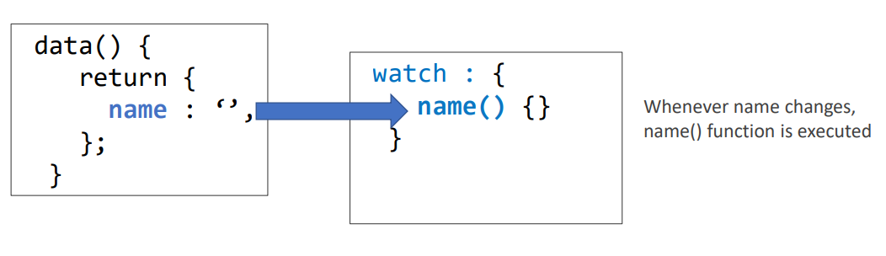
Option State
watch
Type
Details
A watcher is a function that is executed when data changes

Slide 8
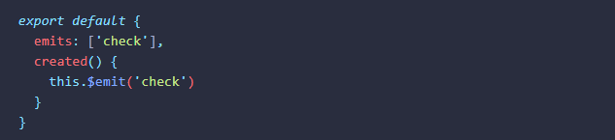
Option State
emits
Type
Details
Emitted events can be declared in two forms:
Simple form using an array of strings
Full form using an object where each property key is the name of the event, and the value is either null or a validator function.

Slide 9
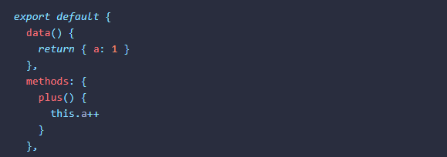
Option State
methods
Type
Details
Declared methods can be directly accessed on the component instance, or used in template expressions. All methods have their this context automatically bound to the component instance, even when passed around.
Avoid using arrow functions when declaring methods, as they will not have access to the component instance via this.

Slide 10
Option Lifecycle
beforeCreate
beforeUpdate
created
updated
beforeMount
beforeUnmount
mounted
unmounted

Slide 11
Option Lifecycle
beforeCreate
Details
Called immediately when the instance is initialized, after props resolution, before processing other options such as data() or computed.
created
Details
Called after the instance has finished processing all state-related options.

Slide 12
Option Lifecycle
beforeMount
Details
Called right before the component is to be mounted.
When this hook is called, the component has finished setting up its reactive state, but no DOM nodes have been created yet. It is about to execute its DOM render effect for the first time.
This hook is not called during server-side rendering.

Slide 13
Option Lifecycle
mounted
Details
A component is considered mounted after:
All of its synchronous child components have been mounted (does not include async components or components inside <Suspense> trees).
Its own DOM tree has been created and inserted into the parent container. Note it only guarantees that the component's DOM tree is in-document if the application's root container is also in-document.

Slide 14
Option Lifecycle
beforeUpdate
Details
Called right before the component is about to update its DOM tree due to a reactive state change.
This hook can be used to access the DOM state before Vue updates the DOM. It is also safe to modify the component state inside this hook.

Slide 15
Option Lifecycle
updated
Details
Called after the component has updated its DOM tree due to a reactive state change.
A parent component's updated hook is called after that of its child components.
This hook is called after any DOM update of the component, which can be caused by different state changes. If you need to access the updated DOM after a specific state change, use nextTick() instead.

Slide 16
Option Lifecycle
beforeUnmount
Details
Called right before a component instance is to be unmounted.
When this hook is called, the component instance is still fully functional.
unmounted
Details
A component is considered unmounted after:
- All of its child components have been unmounted.
- All of its associated reactive effects (render effect and computed / watchers created during setup()) have been stopped.

Slide 17
Reference
https://vuejs.org/api/options-state.html

